Slide 1
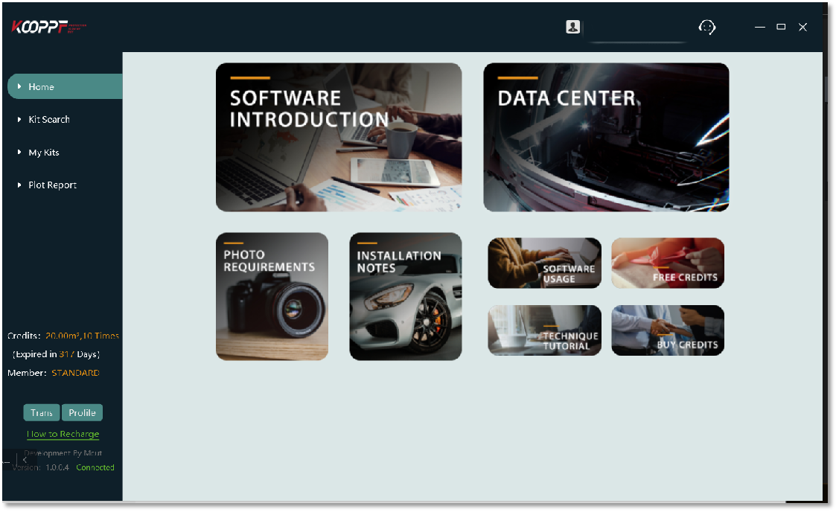
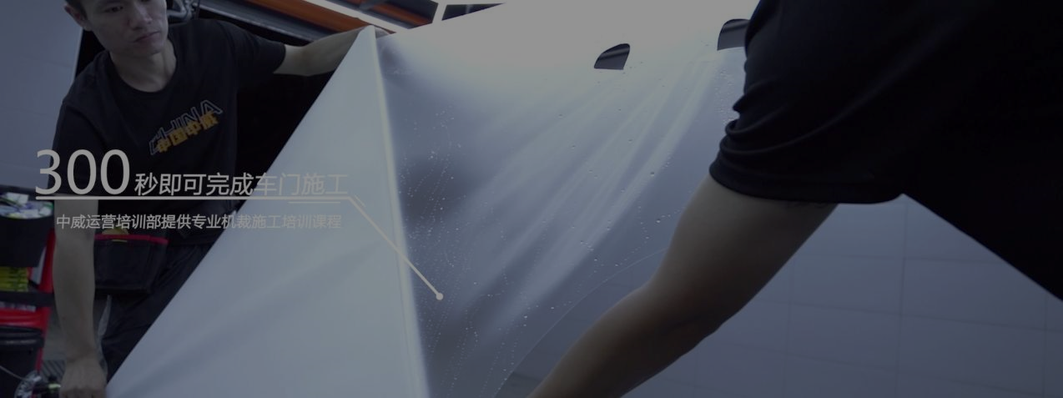
Leading Car PPF Plotting System

Slide 2
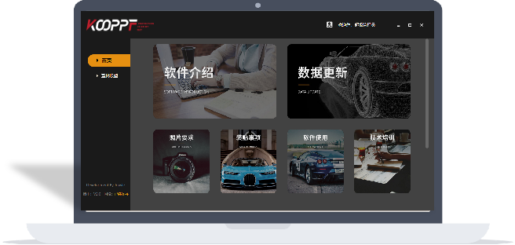

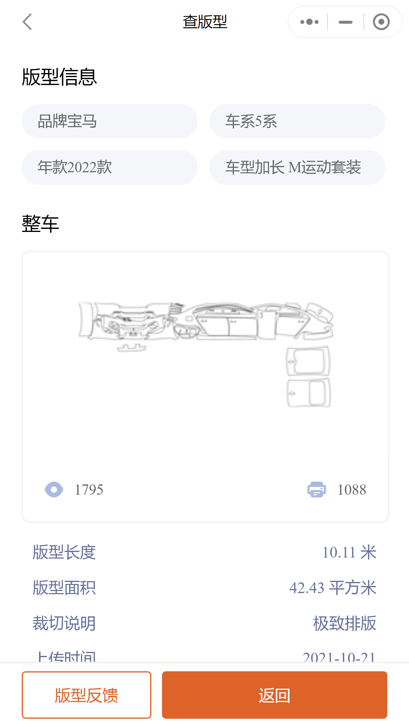
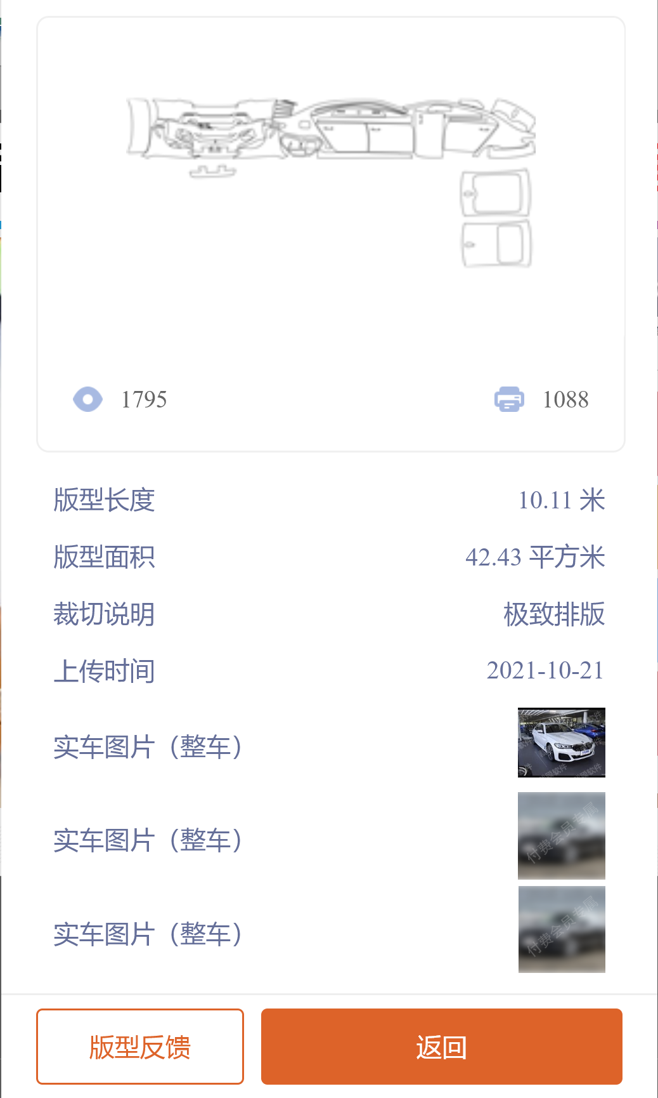
Why customers
Select us ?
Good system
Easy Software & Car Data
Compatibility &
Plotter extension
Service
Info.
&
Mgmt

Slide 3
 | Mantis | Player D | Player Y | Player EM | Player EN | Others
Charges
Expense | Medium | High | High | Free | Medium | Low
Data
Car Data Number | √ | √ | √ | ▲ | ▲ | ×
Car Data Accuracy | √ | √ | √ | × | √ | ×
Database Update | Medium | Fast | Slow | Slow | Ver Slow | Very Slow
Software
Easy to use | √ | × | ▲ | × | × | ×
Friendly UI | √ | × | × | × | × | ×
Editable | √ | √ | √ | √ | √ | ▲
App & Website | √ | ▲ | × | × | × | ×
Sharing function | √ | x | × | x | x | x
After-service | √ | ▲ | √ | × | × | ×
Hardware Compatibility | √ | √ | √ | √ | √ | √
Exclusive Brand | No | Xp | No | L & V | No | No
Extension Plotter Machine | √ | x | x | x | x | x
Store information
Usage analysis | √ | √ | √ | √ | × | ×
Customer Confidentiality | Independent Platform, 100% belongs to customer | Solely | Dependent | Solely | Dependent | NA
Notes:
Competition Analysis

Slide 4

Customer Needs
Shop Owner
Car data accuracy
Car data amount
Easy to use
Customer Information Confidentiality
Detailing
Trial
Cheaper
After-service
Flexible payment choice
Notes:
Customer needs

Slide 5
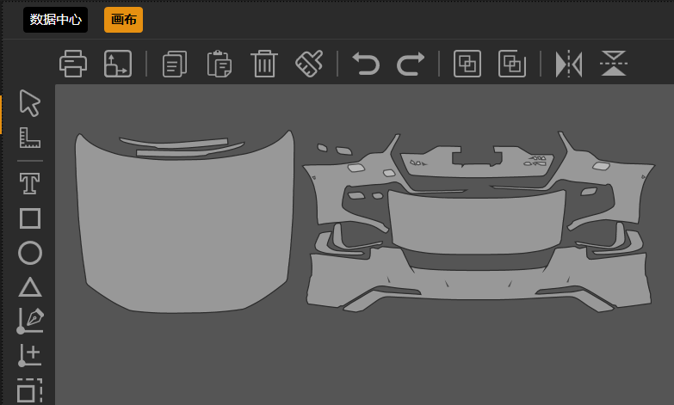
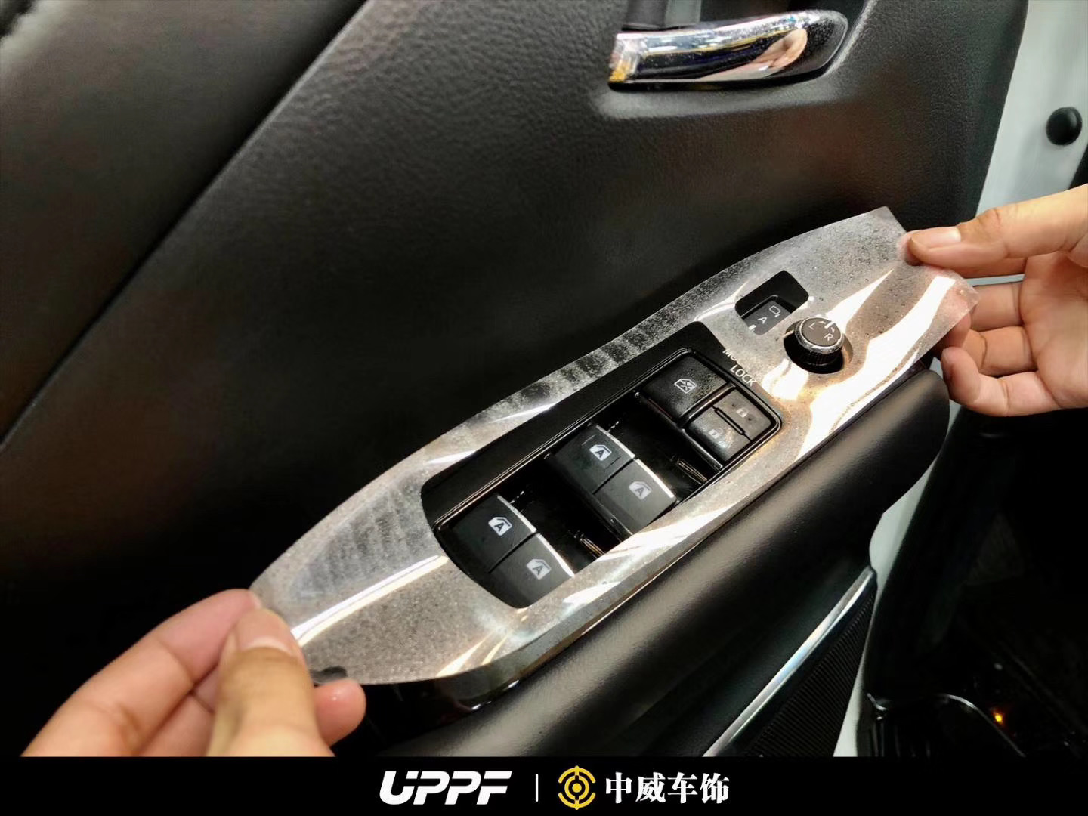
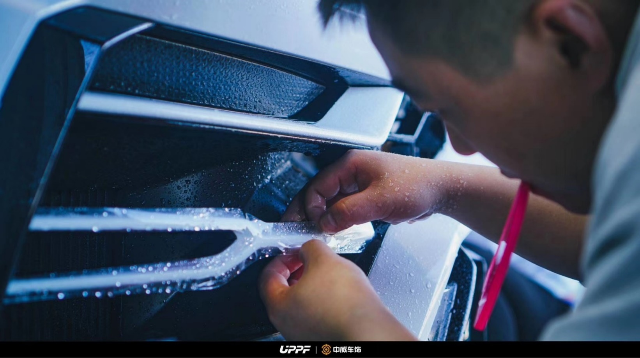
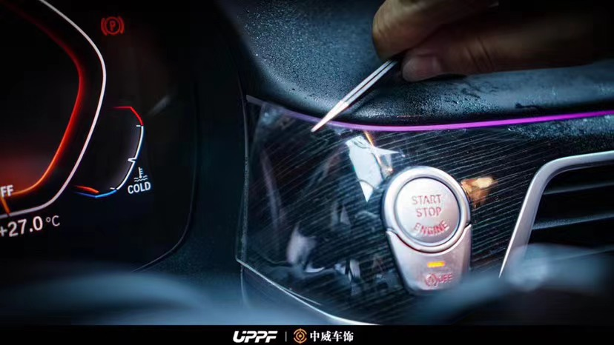
90%
100%
20%
50%
Save Material
Lower Failure risk
Improve professionalism
Raise Efficiency
The four steps
Benefits

Slide 6
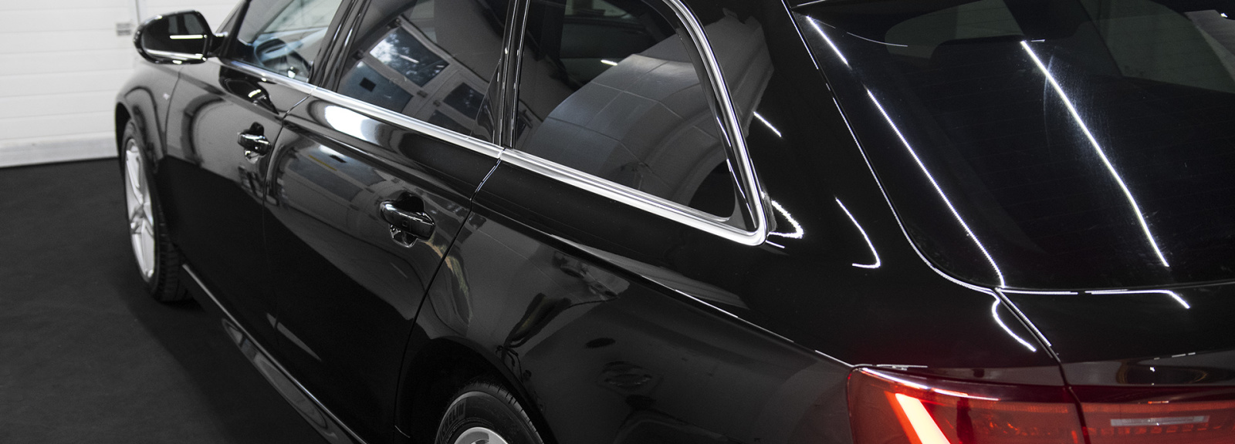
Increasing Every day!
Car brands
Car models
Registered users
Cutting times
Cutting sqm
328+
15000+
3900
90243
500512
Notes:
Car Model Database & Update
需要截至时间
数据需要一致

Slide 7
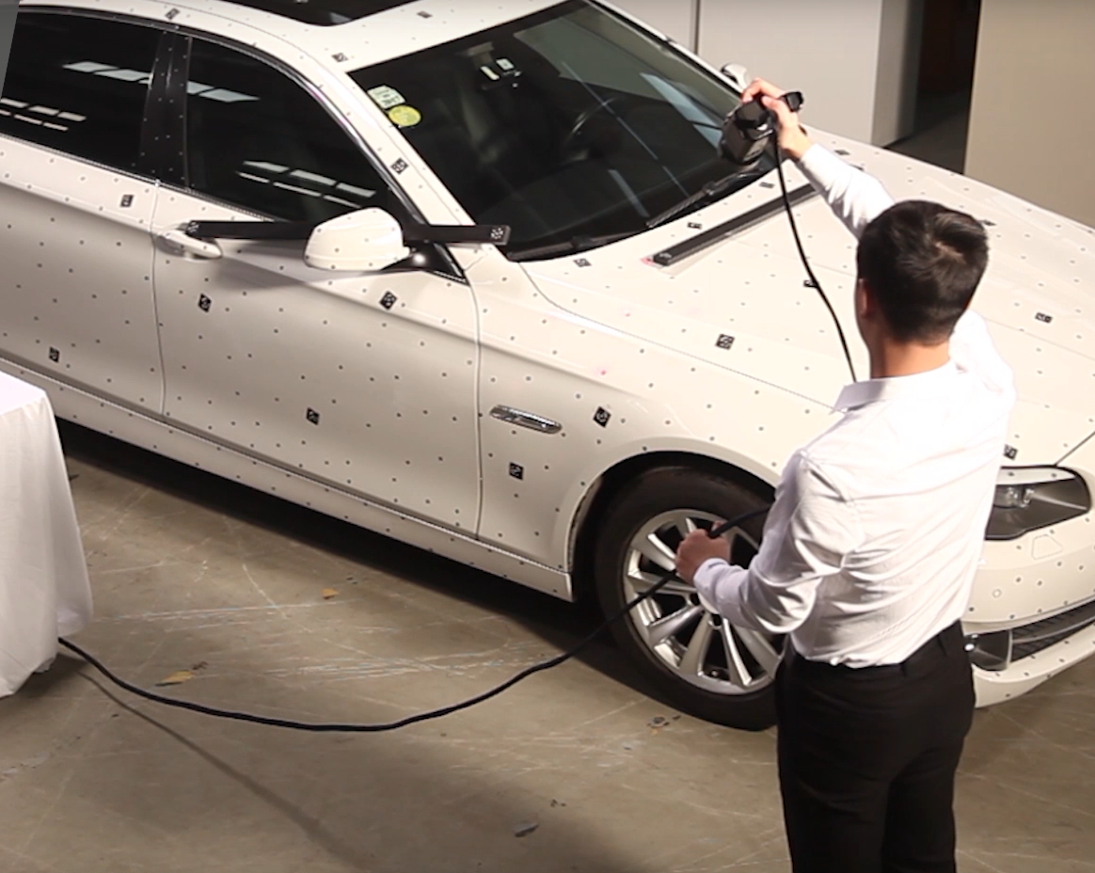
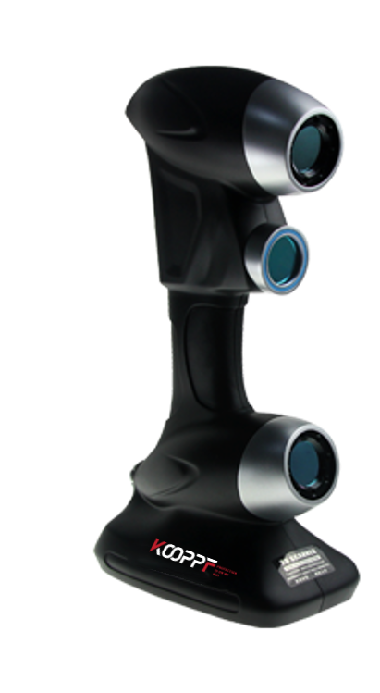
“
3D Scanner
Ultra-high precision
Tolerance < 0.03 mm
High-speed scan
scan 480000 times / sec
Expensive
over 500k rmb / pcs
Fast
3 Days
to scan a car
Accurate

Slide 8
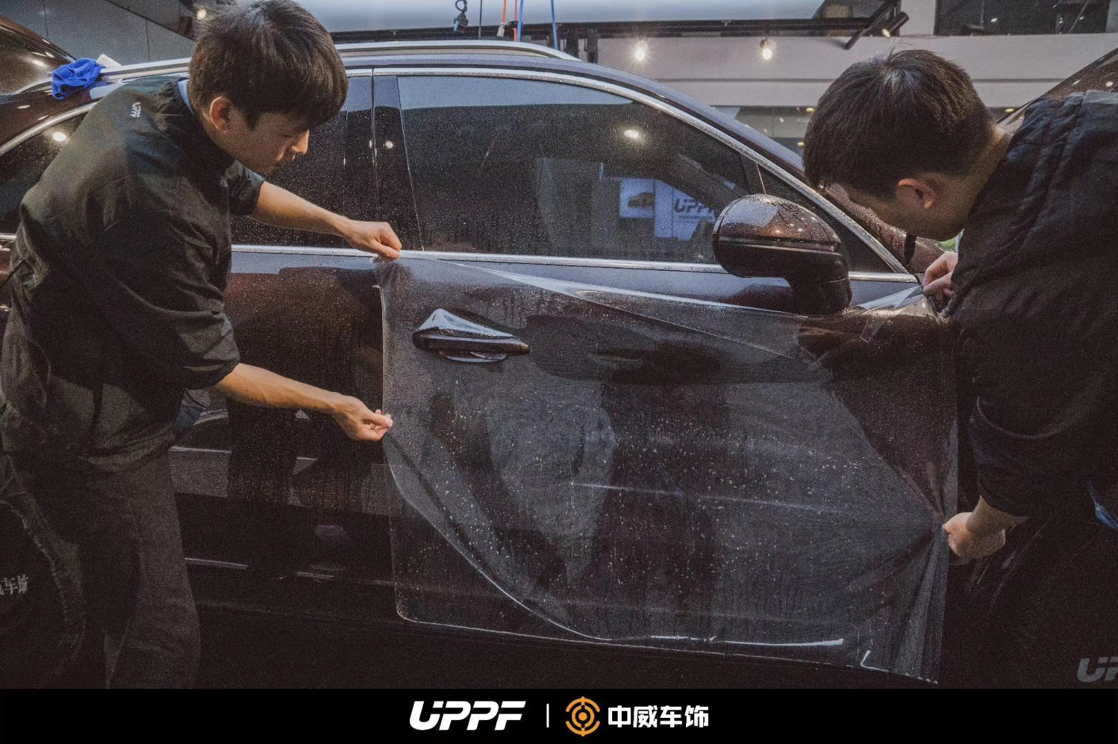

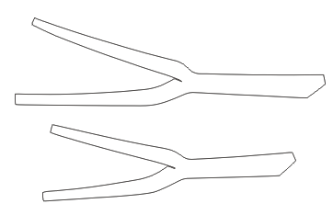

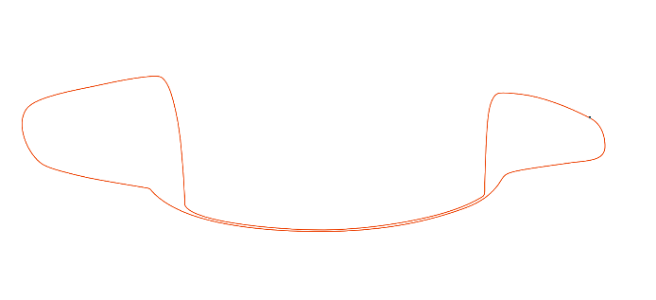
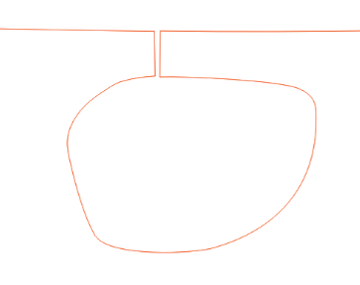
Accuracy
Wrapping Treatment
Junction
Notes:
包边

Slide 9
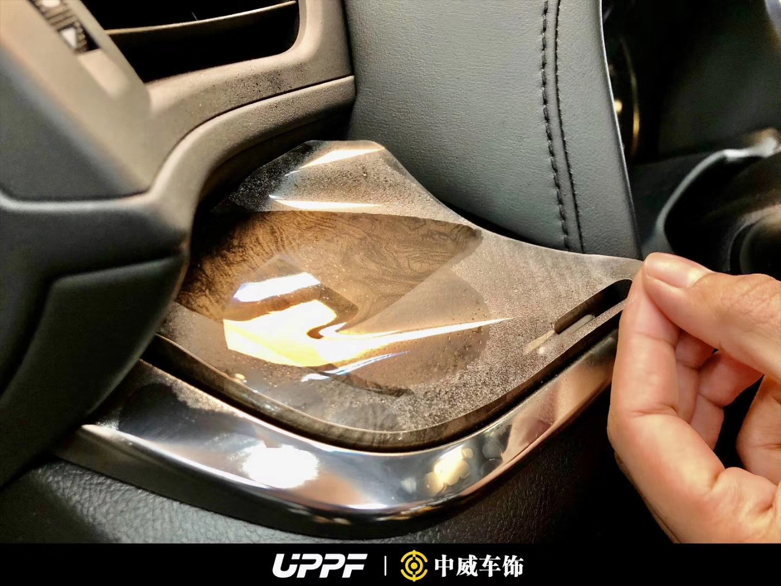
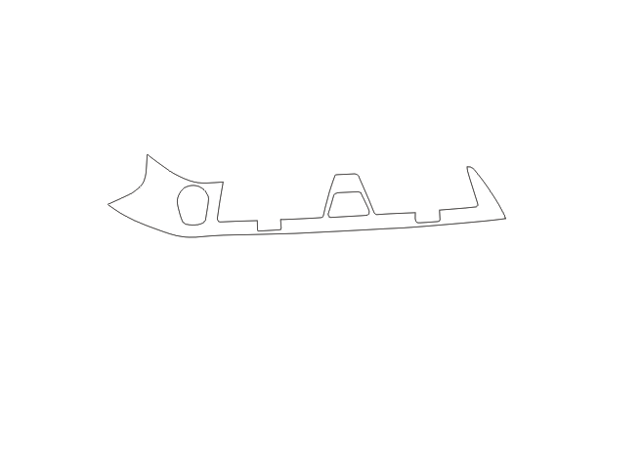
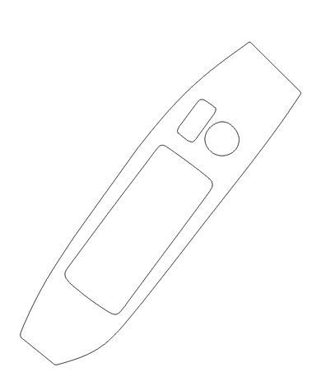

Accuracy

Slide 10
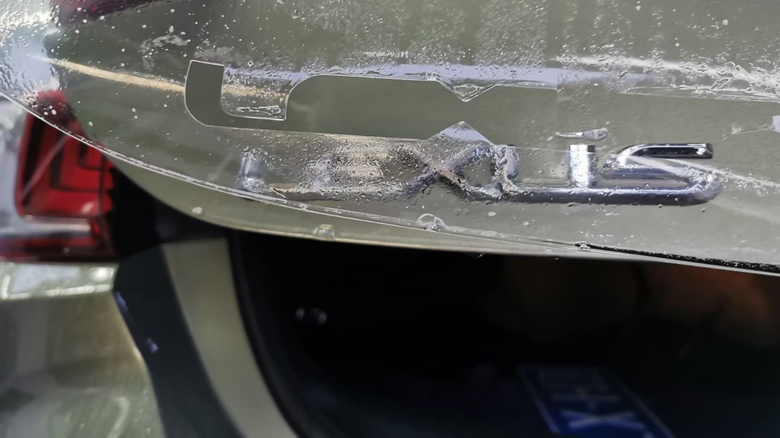

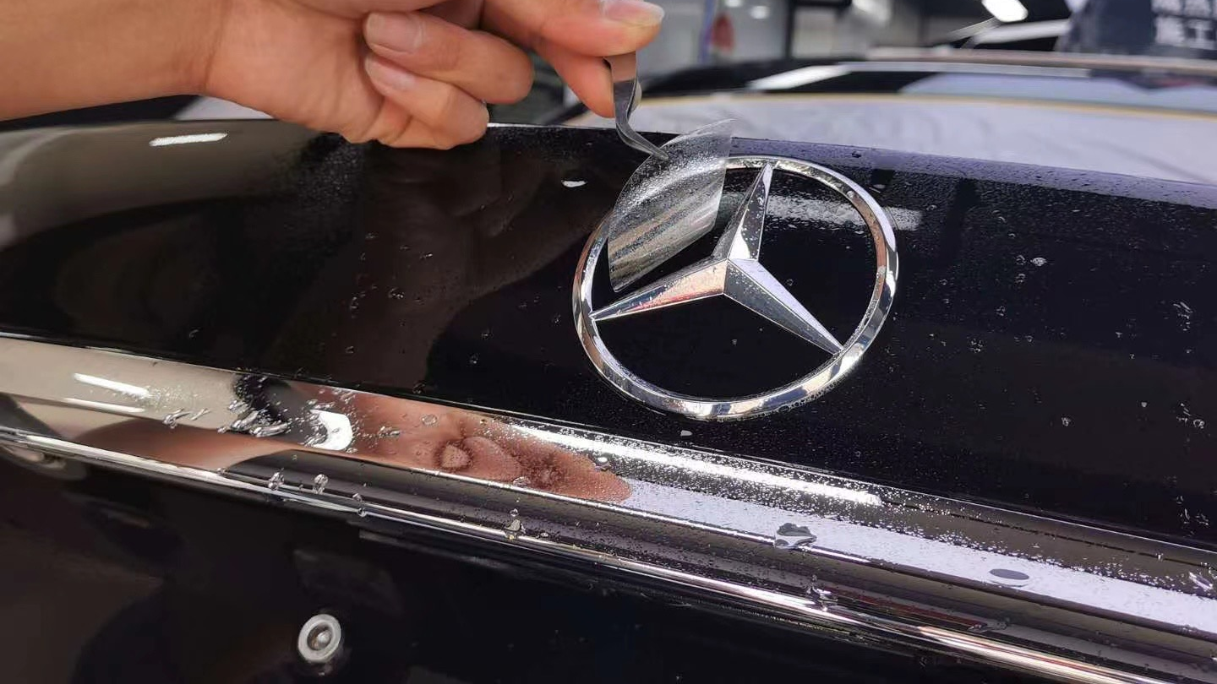
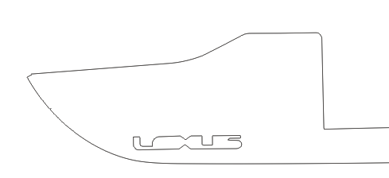
Accuracy

Slide 11
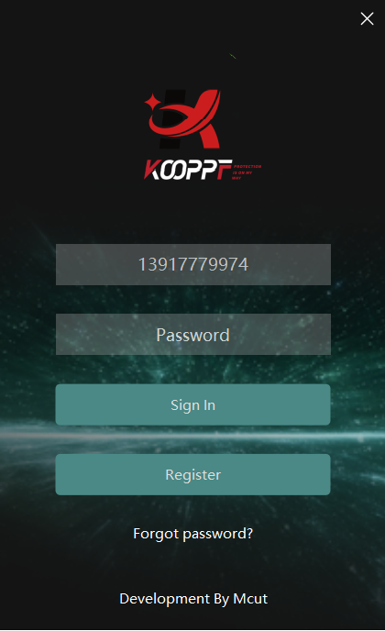
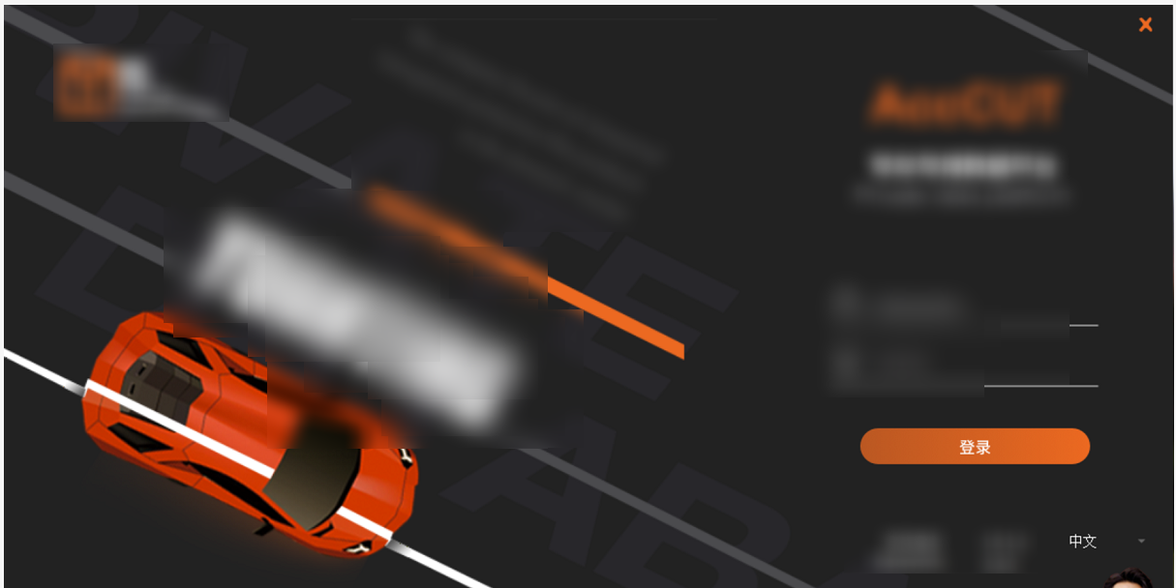
Software UI comparison -
Login interface
Other software （ Sample ）
Mantis

Slide 12
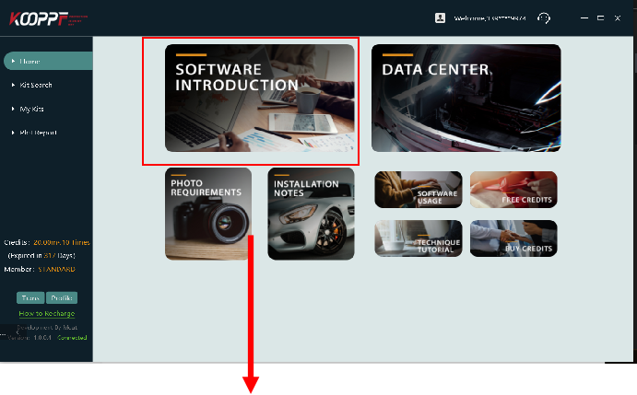
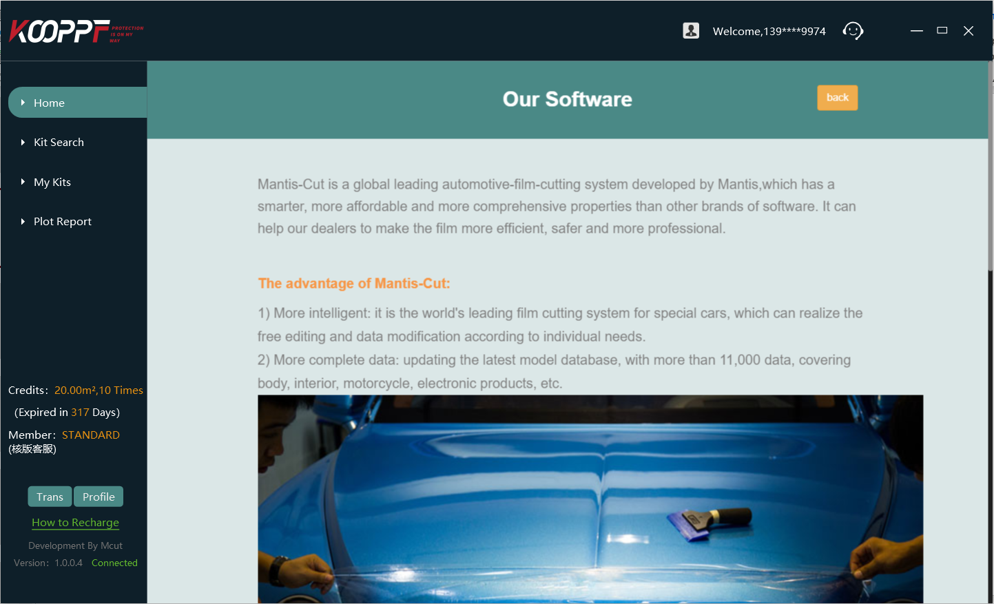
Home Interface
Mantis

Slide 13
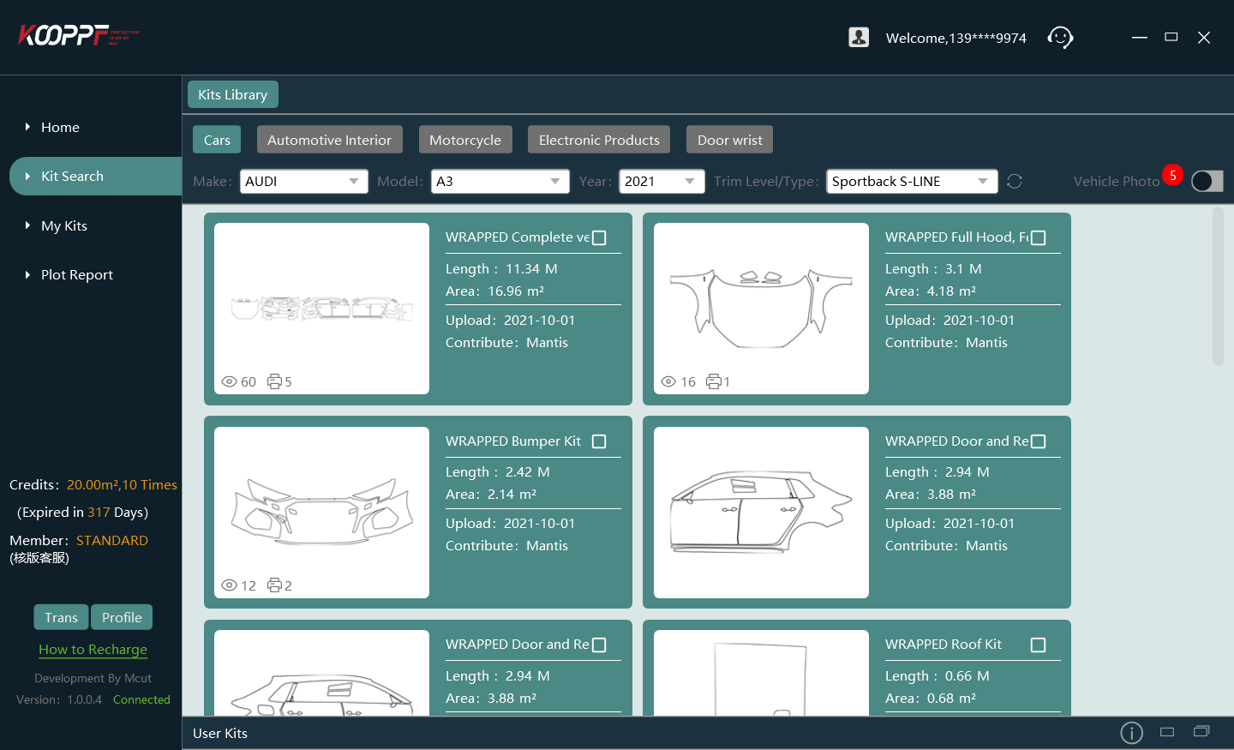
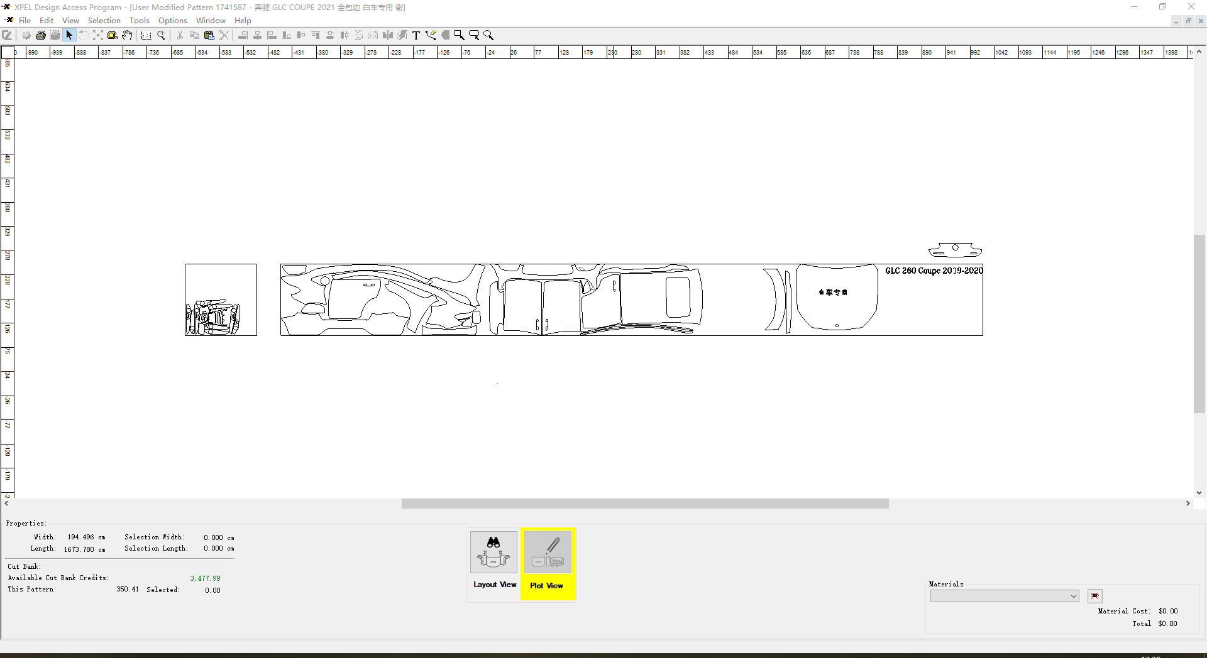
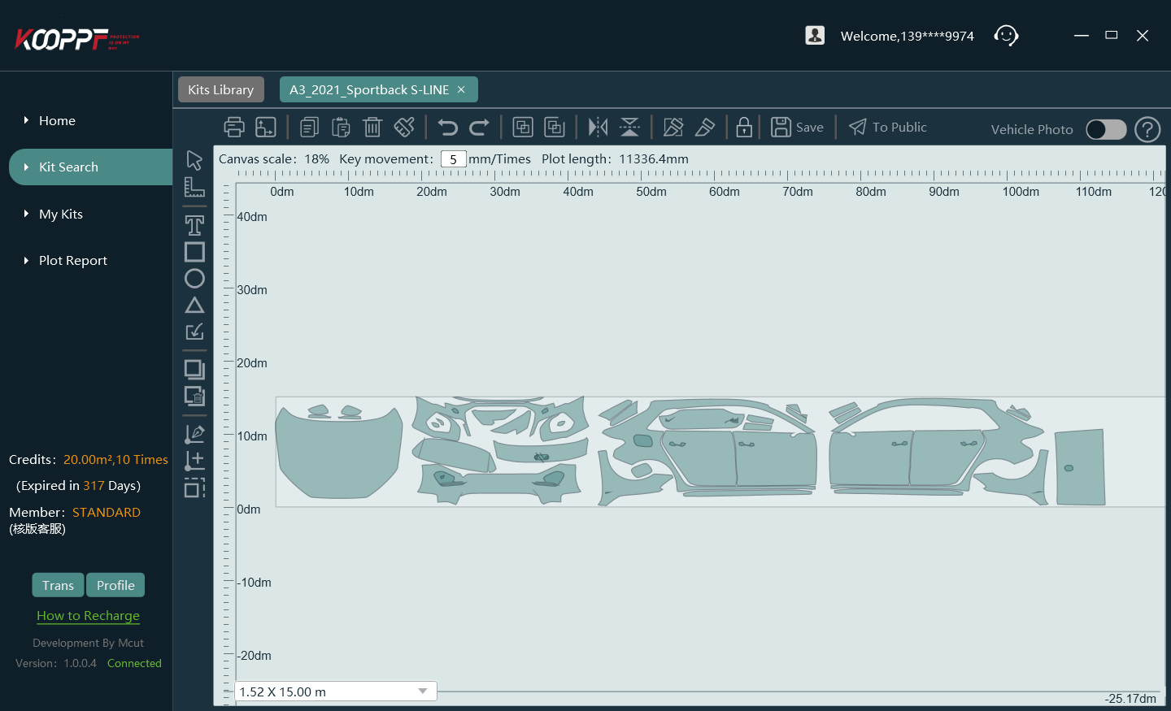
Kit Interface
Other software （ Sample ）
Mantis

Slide 14
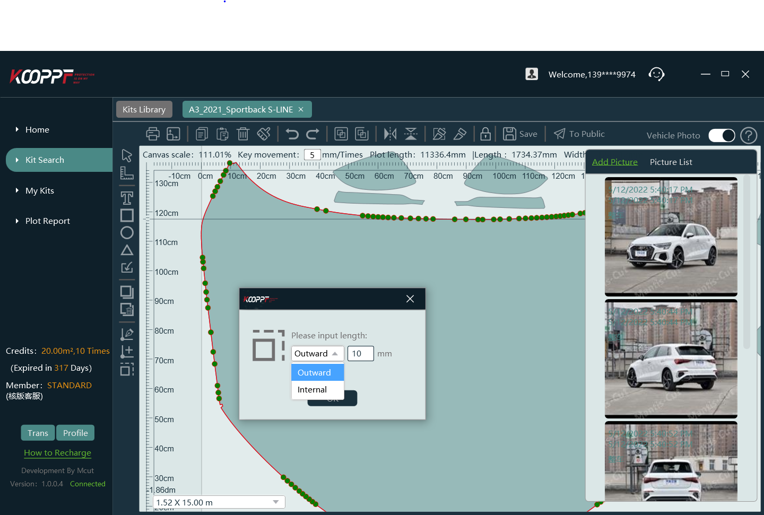
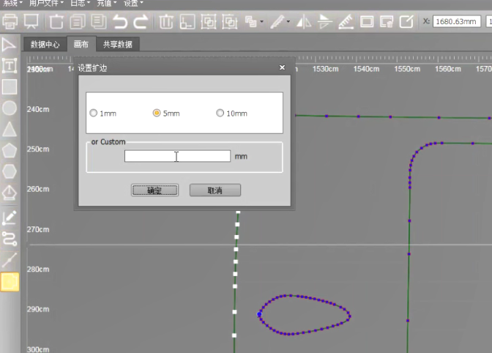
Edit Interface
Mantis
Other software （ Sample ）

Slide 15
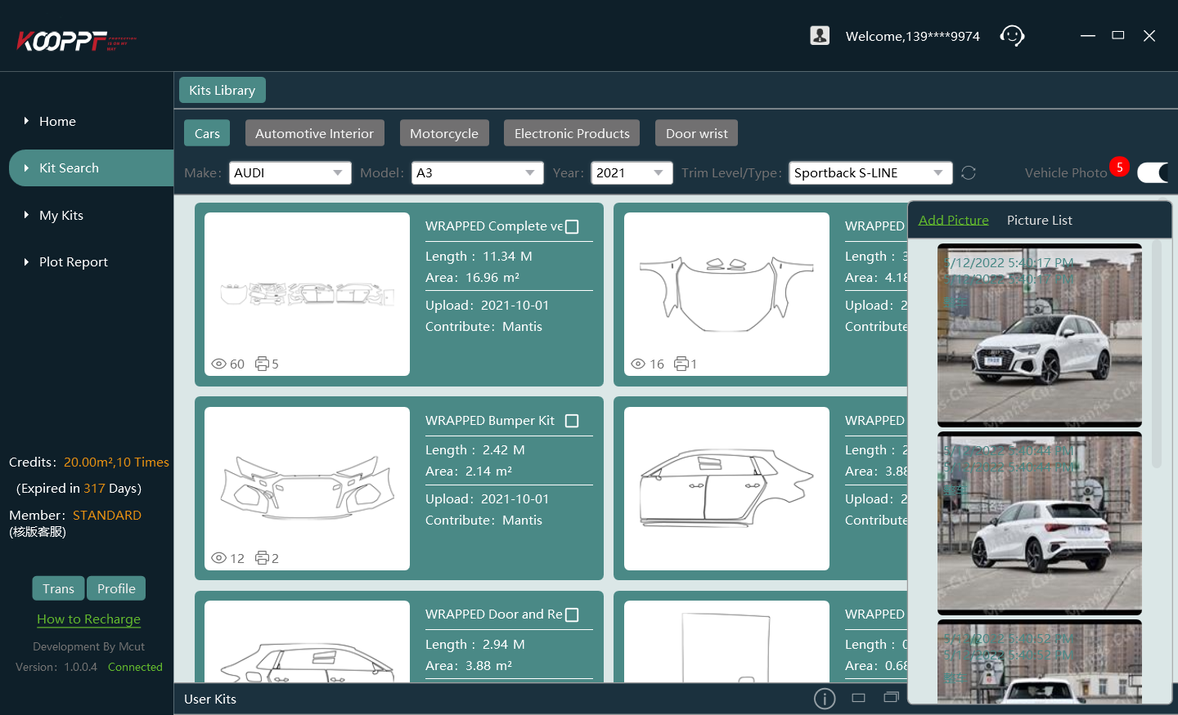
Operation of our software is very easy
Select a pattern
Adjust part layout
Only takes
5 mins
to start your first cut!
Select parts or directly Plot

Slide 16
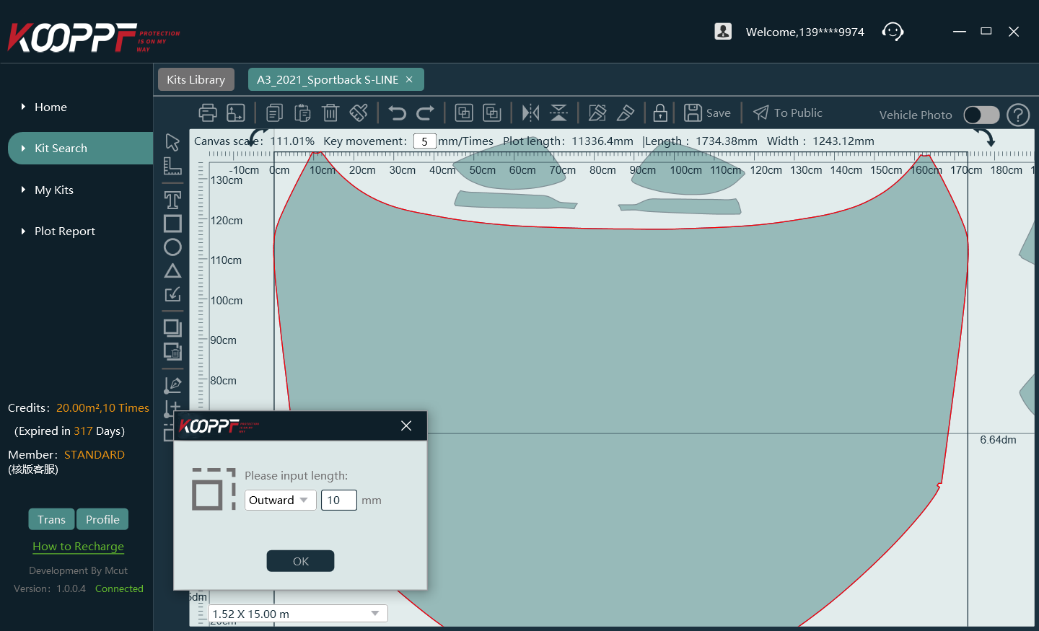
Simple but
Powerful
Customer can understand the function easily through the user-friendly interface, and operate by simply clicking the mouse and input the figure.

Slide 17

Pattern Library Enrichment (PLE) cooperation plan
DIY Pattern could be shared
and creator can get charge.

Slide 18
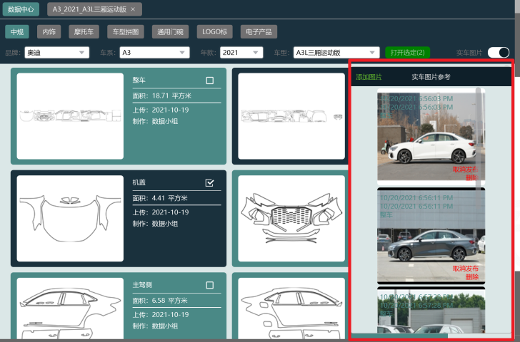
Installer could share
the finish pictures.

Slide 19
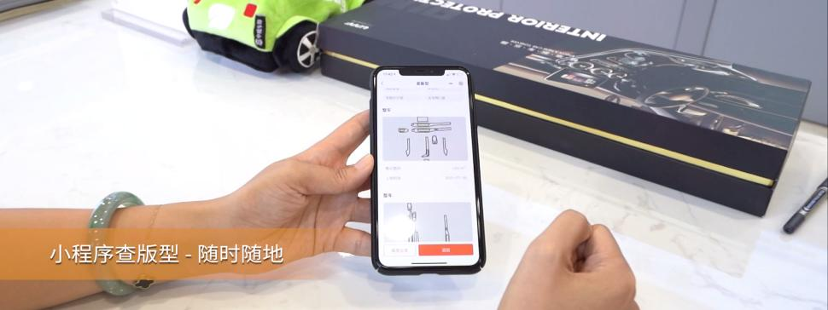
Shop installers can check
the model by app
anywhere
Notes:
Customer needs

Slide 20
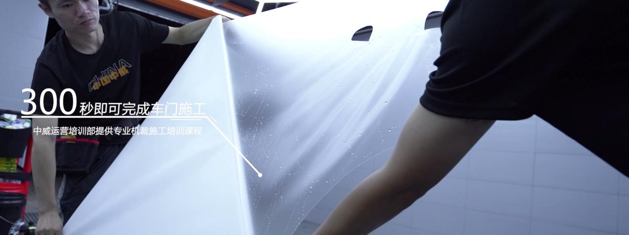
Online tutorial
01
5 minutes to complete the door construction
02
30 minutes to complete the front bumper construction
Only 300 seconds to install a car door!
03
Less film waste skills
04
Software operation skills training (100% pass)
05
Precautions for standard plotter cutting.
06
Less knives, no damage to car paint construction
Notes:
确认这个是谁提供的

Slide 21
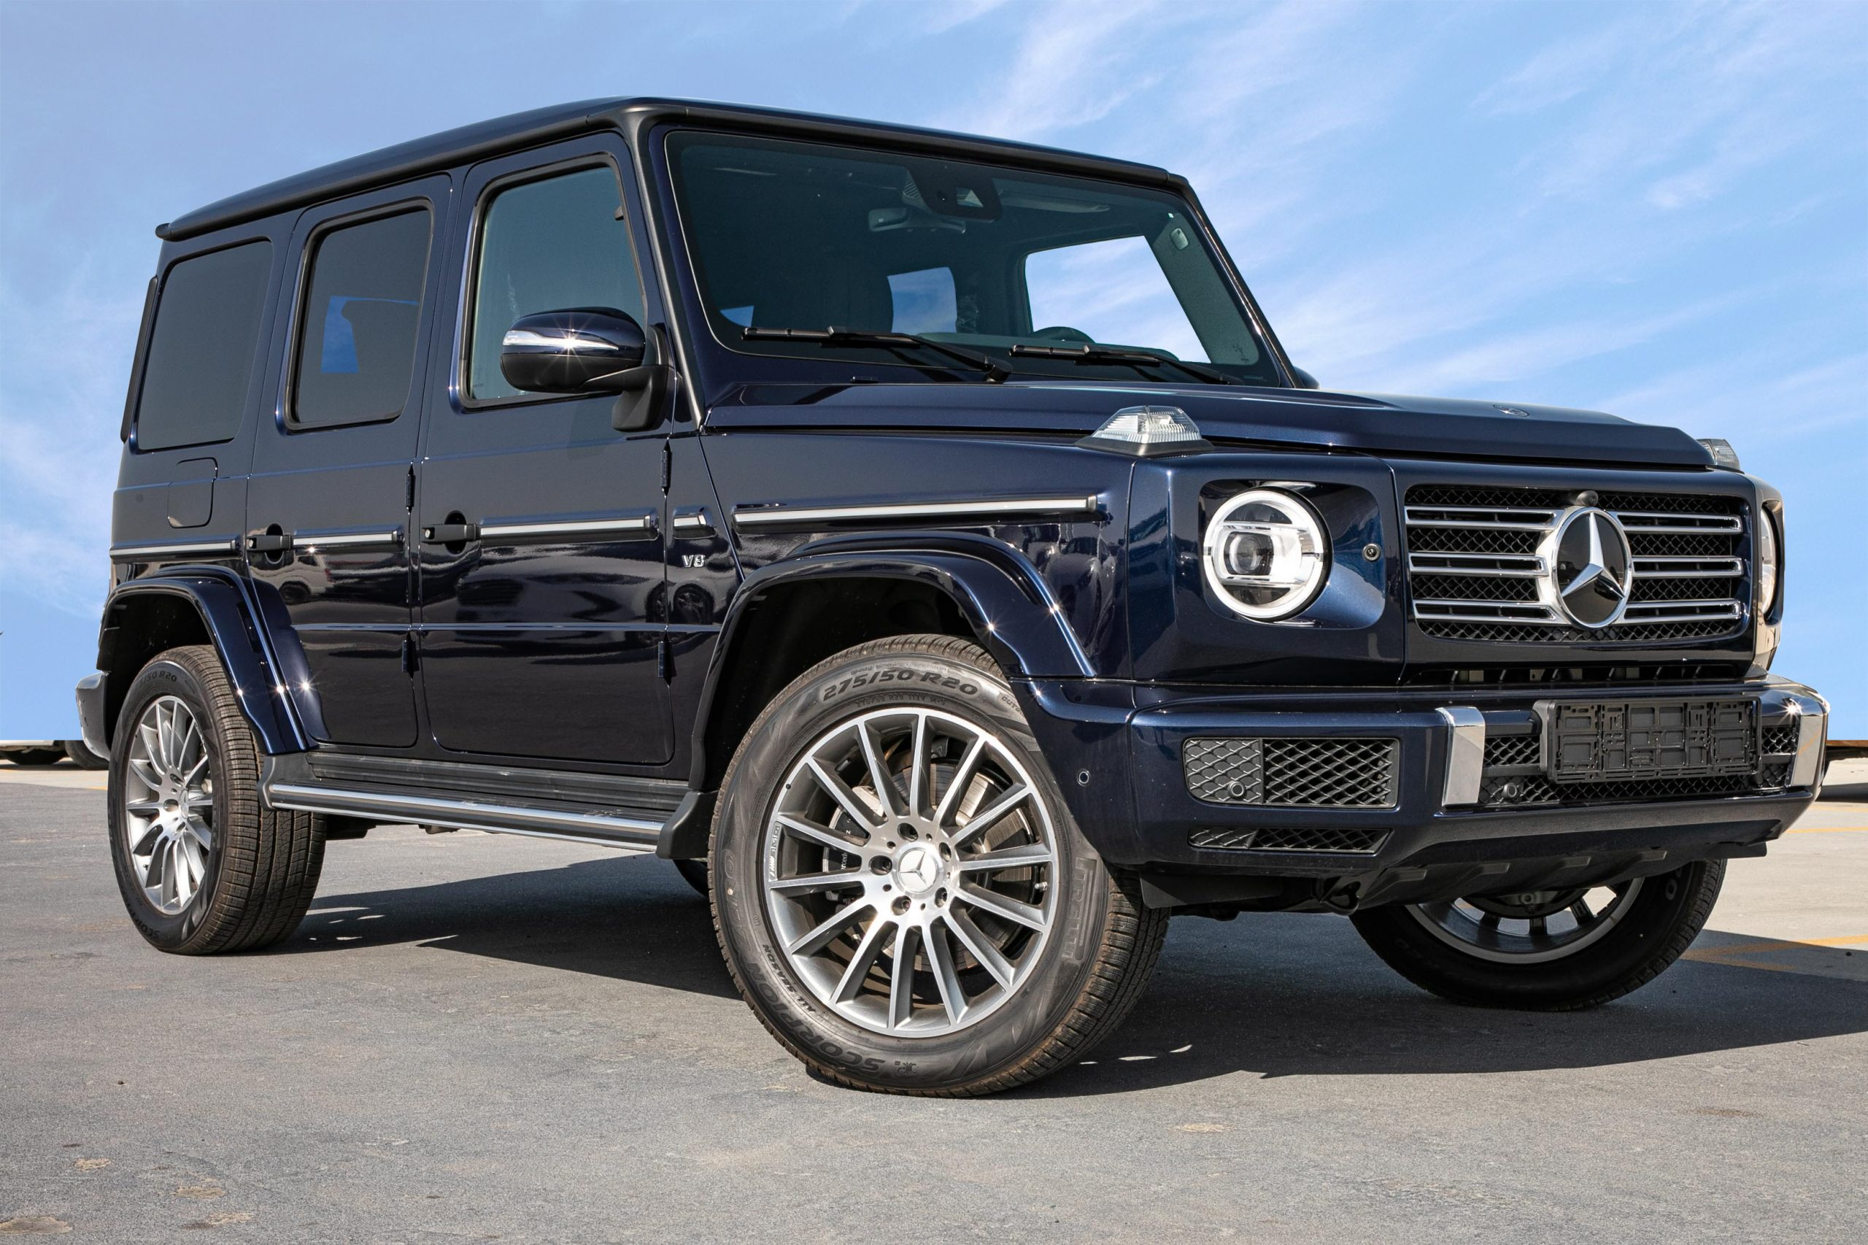
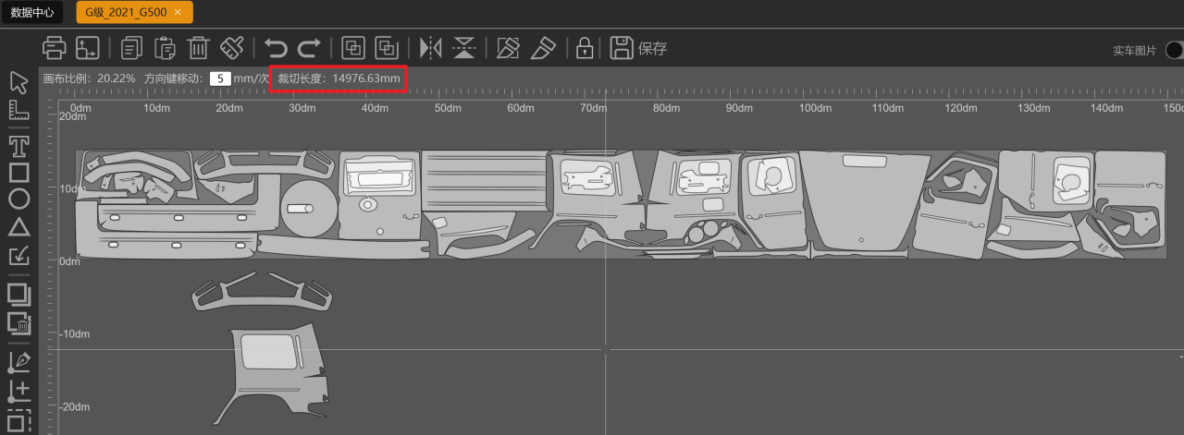
Sample case
Plotter cut:
14.90m
Manual cut:
20~22m
Save 30% material
Benz G500
Save your money!
Notes:
这是膜长？ 为什么2卷膜3台车(无车顶)、3卷膜4台车

Slide 22
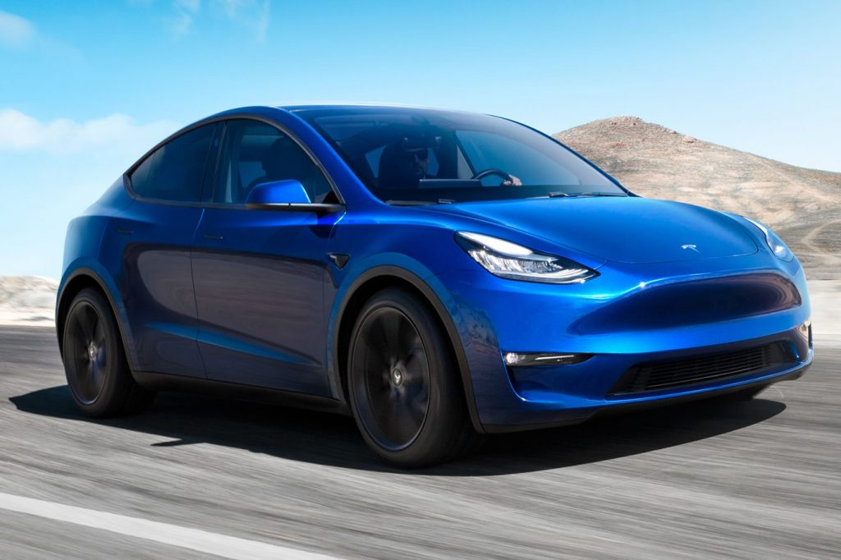
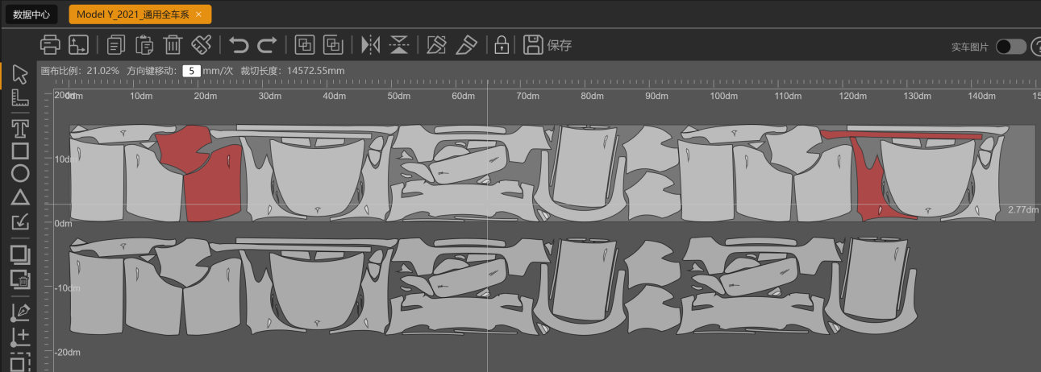
Sample case
Manual Cut:
3 rolls for 3cars
Manual Cut:
2 rolls PPF can paste 3 Cars
Save 33% material
Tesla Model Y
Save your money!
Notes:
这是膜长？ 为什么2卷膜3台车(无车顶)、3卷膜4台车

Slide 23
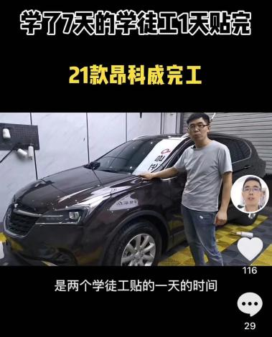
Sample case
Two apprentice who only studied PPF for 7 days, finished a 21’ Angola in just one day
Save your Labor cost!
Notes:
这是膜长？ 为什么2卷膜3台车(无车顶)、3卷膜4台车

Slide 24
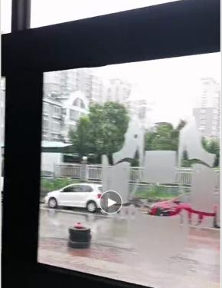
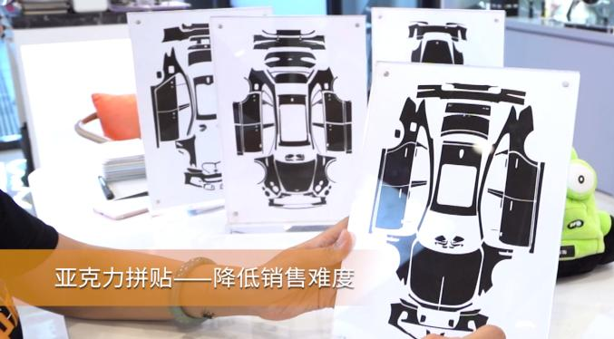
Demonstration
Raise your
professionalism!
Notes:
这是膜长？ 为什么2卷膜3台车(无车顶)、3卷膜4台车

Slide 25
Store cutting deep analysis
Data can help store owners arrange work schedules and order replenishment better.
Cutting area by car brand summary sample
Notes:
无法修改翻译

Slide 26
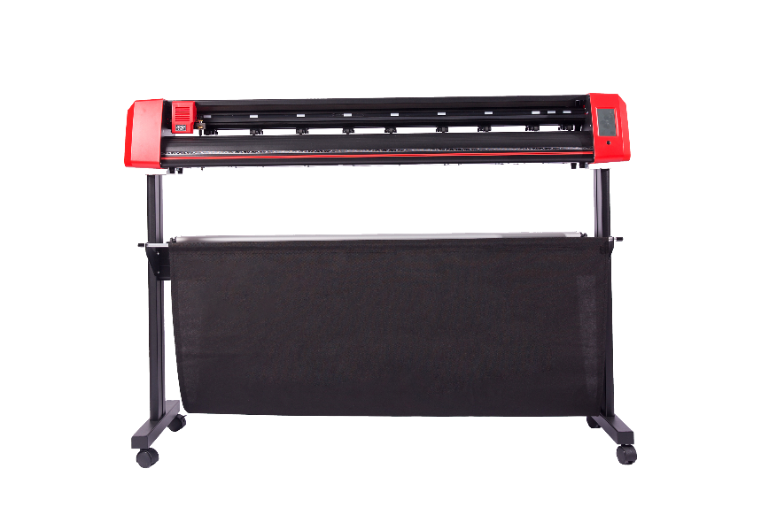
PPF Plotter
Designed for
PPF Plotter

Slide 27
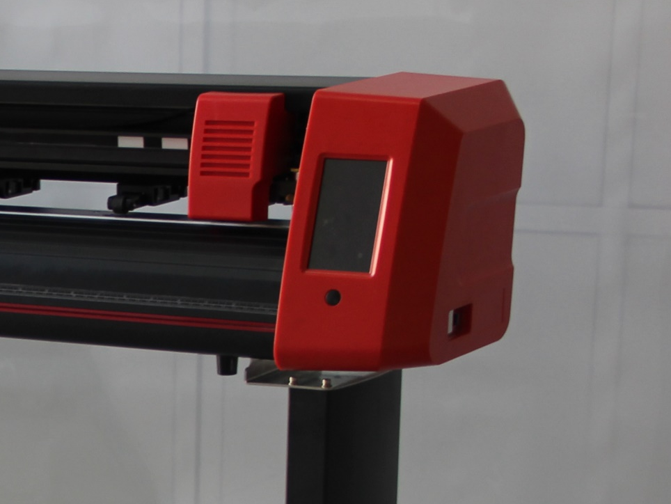
a qualified
Plotter
PPF is a special.
TPU is very soft and thick, it requires high demanding of the sharp cutter and the tracking.
Removing liner will generate strong static electricity to damage the circuit board.
Also the machine needs to be smarter, as operators may not be professional.
Antistatic
95%
Automatically Tracking
85%
Cutter Accuracy
90%
The most suitable
Expense
78%
is the best!
Smarter control
55%
Appearance
35%

Slide 28
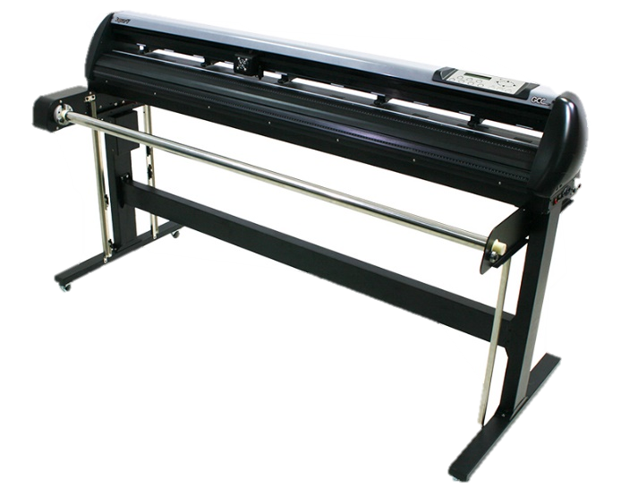
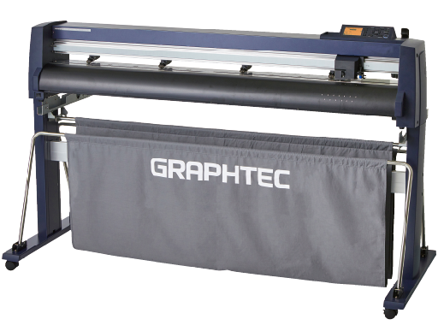
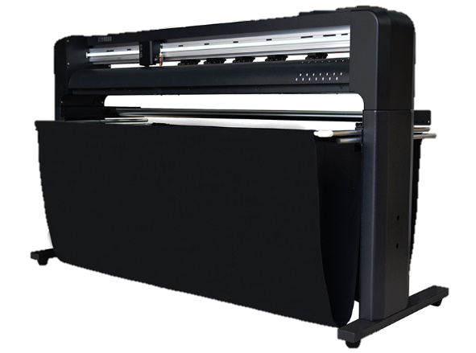
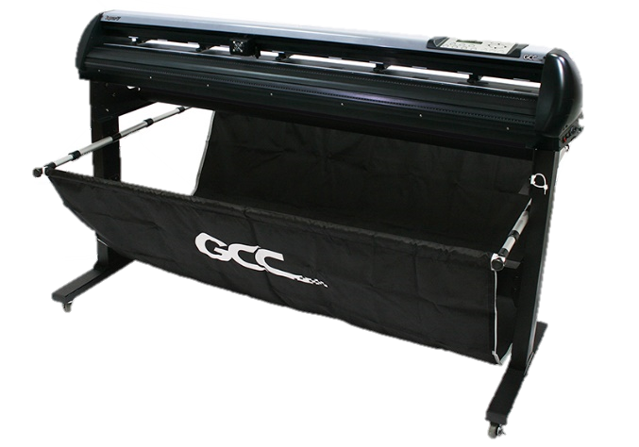
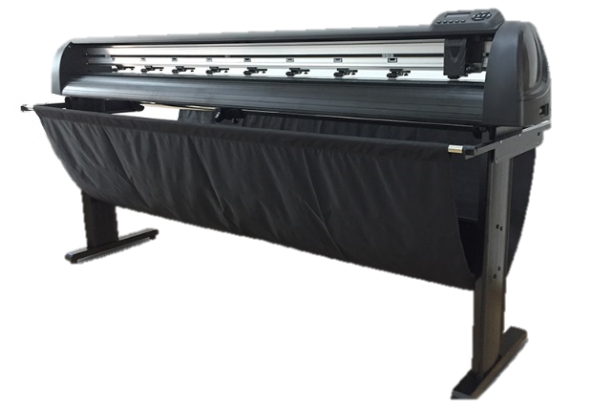

PPF Plotter
$6000
Graphtec 9000
$4500
Jaguar J5-160-C
Jaguar J5-160-P
GR8000-180
$3000
M100
B1800II
$1500
M10
Graphtec
GCC
Gunner
Kele
Mantis-Cut

Slide 29


“
M10 (Entry level)
$ 1738
Suitable for 5 cars/month
Perfect integrated with software
Great accuracy, software compensation
Guarantee 5 meters tracking
1Gb RAM, can continuously work without disconnection
Smart control system, parameter automatically storing system
Cheap
ideal economic
Choice

Slide 30


“
M100 (Professional level)
$ 2769
Suitable for 10 cars/month
Owning all the features of the M10.
LCD Touching control panel
All steel structure, more stable and longer life.
cost-effective
Professional choice

